Slide 1
Database DevOps
Section 1

Slide 2
Course Overview
In this course, you will learn how to:
Define DevOps
Identify the challenges of database DevOps
Include your database code alongside other application code in source control
Setup a Continuous Integration (CI) platform for your database code.
Write and include automated unit tests for your database code.
Develop an automated release process that deploys database changes

Slide 3
Course Structure
This course consists of
Lectures and videos of course material
Assessment questions after each section
Hands on labs for you to practice skills

Slide 4
What is DevOps?
“DevOps is the union of people, process, and products to enable continuous delivery of value to our end users.”
Donovan Brown
Microsoft Principal DevOps PM
From http://donovanbrown.com/post/what-is-devops

Slide 5
What is DevOps?
“It is very important to realize that DevOps is not a product. You cannot buy DevOps and install it. DevOps is not just automation or infrastructure as code. DevOps is people following a process enabled by products to deliver value to our end users.”
- Donovan Brown

Slide 6
The Three Ways
Gene Kim of The Phoenix Project and The DevOps Handbook, lists three core principles of DevOps
Systems Thinking
Feedback Loops
Culture of Continuous Learning and Experimentation

Slide 7
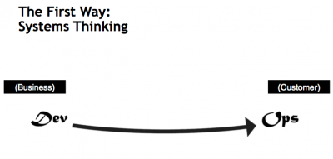

Slide 8
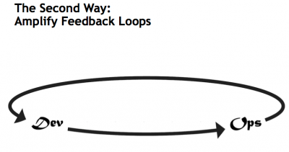

Slide 9
